Slide 1
Advocacy Campaigns
Starlight Stadium
Episode 4
Notes:
This slide deck is designed to provide relevant instruction surrounding Starlight Stadium: Episode 4. Trainers should feel at liberty to use or adapt this slide deck to their own purposes, depending on how the game will be played, and what experience level their students possess.

Slide 2
What is a Human Rights Change?
Notes:
This is a prompt for learners to brainstorm and consider the different forms that change can exist – legal amendments, change in values/attitudes of the public, creation of new social programs, etc.

Slide 3
Advocacy
The practice of carrying out strategic actions to influence change in a particular area* on local, national, and international levels
*for example, human rights
Notes:
This is a fairly technical definition of advocacy, and might not resonate with new learners – consider coaching them to define it in language that makes sense to them. For example, help them decode the following key terminology:
“Strategic Actions”
“Influence Change”
“Local, National, and International Levels”
Additionally, try to make connections between the act of “influencing change” with the types of change they brainstormed in the previous slide. Using an example of an identified human rights change, can learners:
Identify if that change is a local, national or international level of change
Identify the strategic actions that one might take to influence said change.

Slide 4
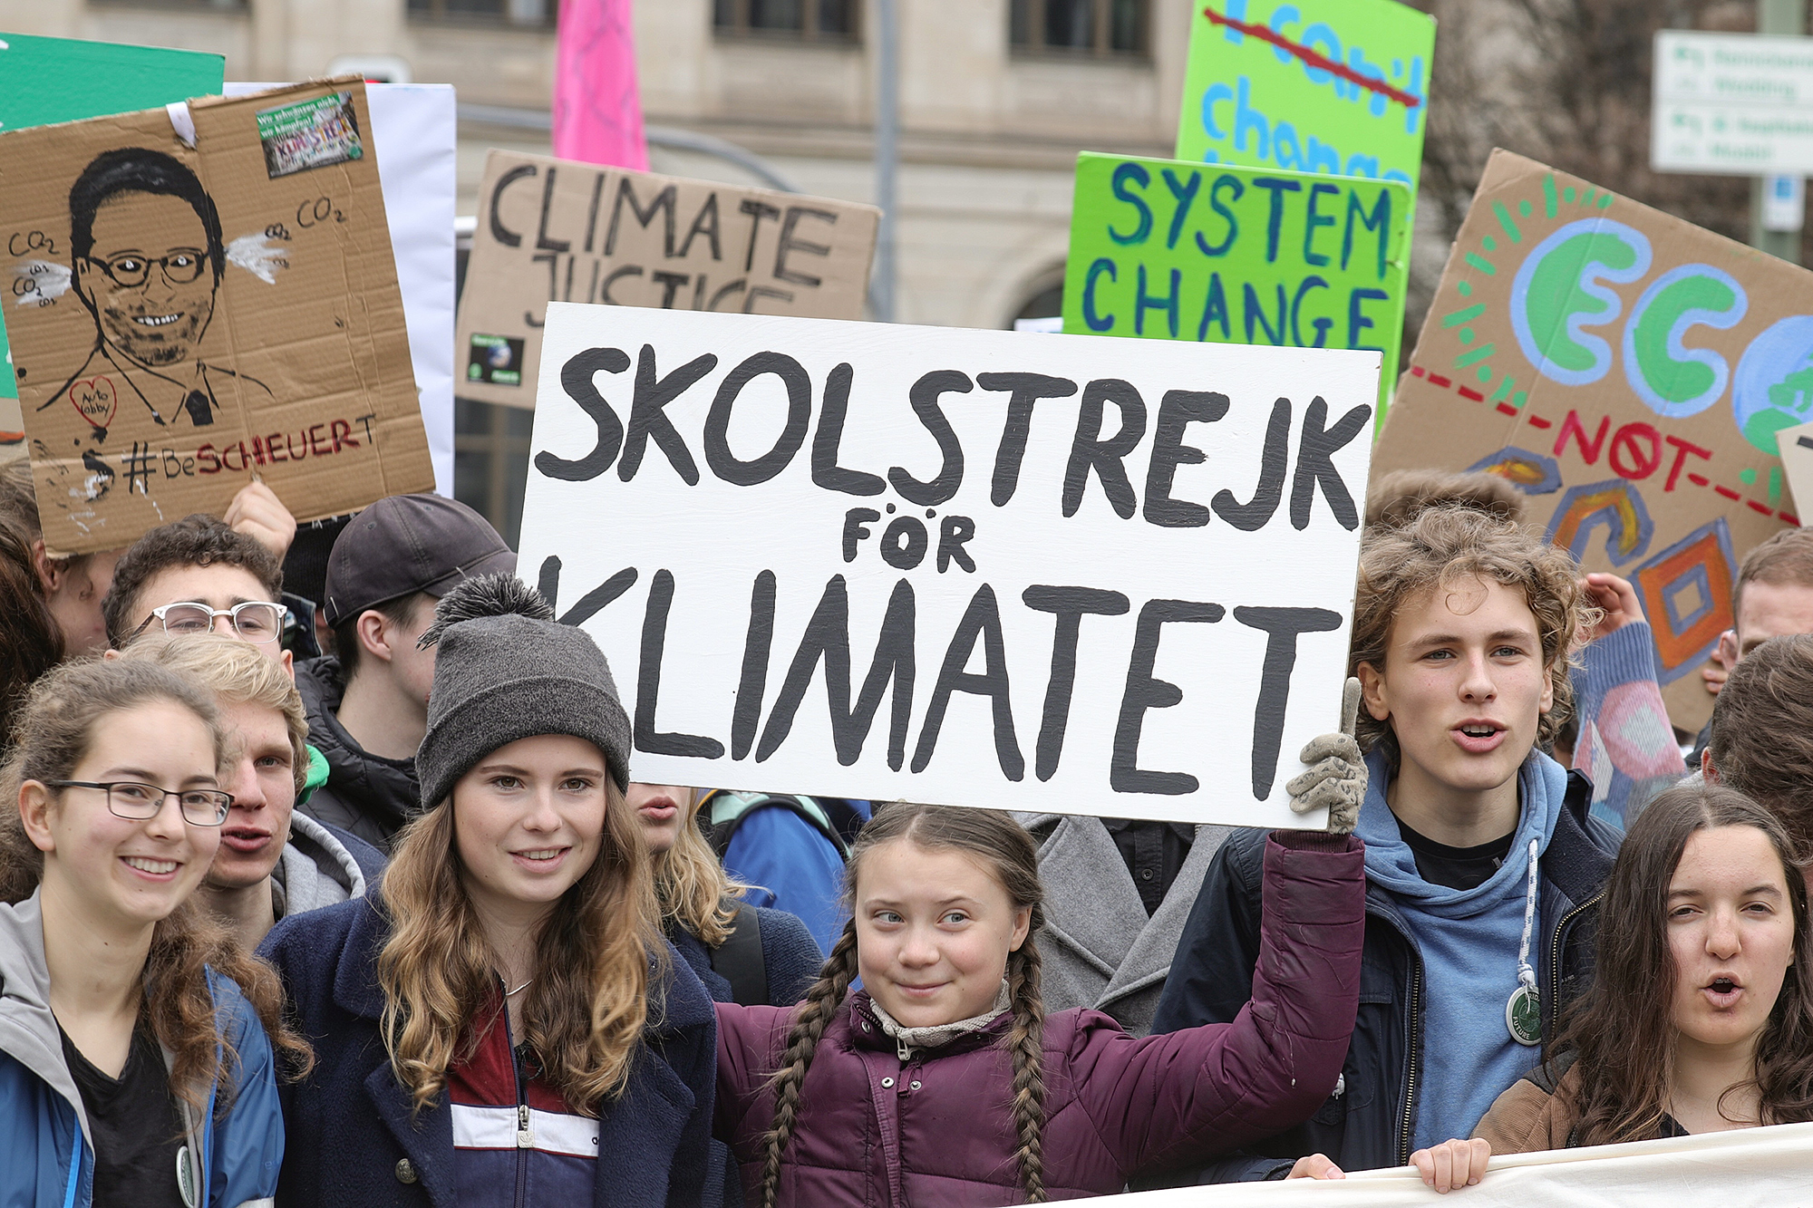
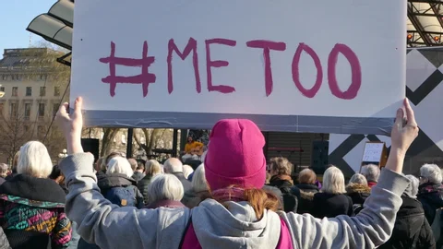

Notes:
Ask Students if they recognize any of these Advocacy Campaigns, and try to help them identify the Human Rights Change that each is trying to (or successfully did) enact, along with the types of Strategic Actions that the campaign employed. A quick review is provided below:
Fridays For Future – global climate change awareness, via organised public protests
MeToo Movement – stronger sexual assault legislation and cultural awareness, via protests and heavy social media campaigns
Flash Drives for Freedom - fight against the lack of information in North Korea by having people donate flash drives, which are then loaded with various media and smuggled in.
Ask students if they can think of other advocacy campaigns that have occurred in their communities. Help them think of these campaigns through the lens of “desired outcome” and “actions taken” by the group.

Slide 5
While advocacy campaigns are typically highly visible, they don’t just appear out of nowhere -
Behind the scenes, lots of Human Rights Defenders are working to make things happen
Notes:
Remind learners that advocacy campaigns need to be planned and operationalised, and are mostly done so by Human Rights Defenders. Perhaps ask the group to identify recent community-specific campaigns and who was behind them.

Slide 6
Stakeholder Mapping and Analysis
Who should we talk to?
Communications Outreach
How do we talk to them?
Resource Allocation
What tools do we have?
Notes:
The goal here is to get learners to start thinking about the advocacy campaigns that they’ve seen not just from a “consumer” perspective, but from a “producer” perspective. Ask them to think about the campaigns discussed in the previous slides (either the provided examples or the ones they came up with on their own), and what kind of pre-planning would have needed to happen to support the “actions taken” by the group.

Slide 7
While Advocacy Tasks can be the most publicly visible part of a campaign, there’s also a lot of behind-the-scenes preparation that HRDs need to consider:
Physical Safety – maintaining the personal security of all their assets, including team members, stakeholders, office premises, etc.
Digital Security – protecting information and communications,
Mental Wellbeing – managing emotional self-care
Notes:
Encourage learners to brainstorm the kinds of things that could threaten the physical safety, digital security, and mental wellbeing of HRDs working on an advocacy campaign, and then also brainstorm the steps that an organisation could take to mitigate those challenges.

Slide 8
Advocacy is about participation in public life, and participation is a human right
Notes:
Remind learners that states are obliged to establish mechanisms for people to be able to participate and influence decisions in their communities meaningfully and peacefully, and fundamentally the advocacy work of a HRD is about helping people engage with these mechanisms.

