Slide 1
Information Gathering
Starlight Stadium
Episode 2
Notes:
This slide deck is designed to provide relevant instruction surrounding Starlight Stadium: Episode 2. Trainers should feel at liberty to use or adapt this slide deck to their own purposes, depending on how the game will be played, and what experience level their students possess.

Slide 2
Information Gathering Skills
Risk Assessment
PEACE Model of Interviewing
Best Practices for Direct Observation
Notes:
This presentation provides an overview of three specific techniques that human rights observers use to gather accurate information while protecting the safety of everyone involved, including themselves.

Slide 3
Risk Assessment - Introduction
Identify Possible Threats
Evaluate their likelihood
Plan ways to minimize their impact
Notes:
In a nutshell, risk assessment is about reducing danger by planning ahead and taking appropriate actions. While we’ll be talking about things in a human rights framework, the concepts are broadly applicable to everyday situations as well.
You might ask students to consider an easily understable situation that requires some clear risk assessment – for example, “going out for a fun night in a foreign city that you’ve never been to before.” Ask them what kinds of things they’d do to stay safe in such a situation, and help them see how their answers represent ways to minimize threats that they have already identified and evaluated the likelihood of.

Slide 4
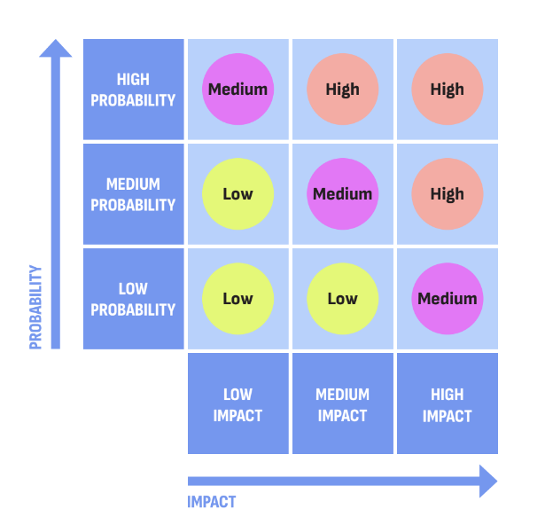
Risk Assessment - Matrix
A model to compare a risk’s likelihood of occurring against the negative impact if it were to occur
Notes:
The Risk Matrix is a way to quantify risks – to help make them tangible enough for us to think about them, and spend our resources on the highest risks. While many things could go wrong in a situation, not all of them are likely to, and on top of that, some negative outcomes are far worse than others. It’s simply not possible to make a plan for every single outcome; this matrix helps us define the problem space better.
As a group, you could revisit the scenario from the previous slide and discuss where various risks would fall on this matrix – you might even include some outlandish ones, to show, for example, how a “certain, negligible” risk would be categorized, as well as an “unlikely, catastrophic” one.
Examples of risks:
Physical: risk of being attacked for your work;
Digital: risk of files being hacked;
Mental: risk of burnout when managing caseload.

Slide 5
PEACE Interviewing
P – Plan and Prepare
E – Engage and Explain
A – Account
C – Closure
E - Evaluation
Notes:
Interviewing subjects is one of the most common ways Human Rights Defenders gather information for their cases, and having a standardized procedure is a good way to balance obtaining reliable data with the well-being of the interviewee. Explain that PEACE is an acronym that represents the steps, in-sequence, of an effective and ethical interview.
Planning and Preparing means setting clear goals for the interview, and carefully considering the needs—and challenges—of a particular interviewee.
Engage and Explain means that before asking any questions, you make sure that the interviewee understands who you are, what you’re going to be asking about, and why you’re asking about it.
Account is what most people think of as “the interview” proper. It’s when you get the interviewee’s account of relevant events.
Closure means ending the interview in a deliberate and thoughtful manner, especially important if—as human rights defenders often are—you’re asking the interviewee to talk about a traumatic experience.
Evaluate. As interviewing is a constant skill that Human Rights Defenders must practice, taking time to review what went right and wrong is an important step.
Trainer could conclude by flagging that this model promotes an approach which goes beyond the interview itself:
Inter-dependency of each step: if you miss or mess up one, you are more likely to miss or mess up more;
Collaboration: PEACE interviewing is not a one person job; it requires involvement of different field of expertise (security, psychology, translation, etc.);
The strategy promotes a holistic approach to interviewing.

Slide 6
PEACE Interviewing - Engage and Explain
“Engage and Explain” is about building trust, which is key to ethical interviewing. To that end, it is important to make sure that:
You obtain informed consent before you start the interview
Your statements are accurate and factual
Your interview “does no harm.”
Notes:
We’re putting an extra emphasis on engaging and explaining because it encompasses one of the most important aspects of interviewing: informed consent. Without your subject officially agreeing to be interviewed as part of your mission, their account can’t be included in your official report. Informed consent contributes towards the realisation of other human rights monitoring principles, as it can strengthen your credibility, gender sensitivity, accuracy, and legitimacy.
Additionally, from an ethical perspective, informed consent is about respecting a person’s human dignity, and treating them as a human being, not just an information resource.

Slide 7
PEACE Interviewing - Account
Your approach to the “Account” phase of your interview should take into consideration what information you need, but also how you can most effectively gain that information in a trauma-informed manner.
Understand the impact of trauma on memory
Employ interview techniques that facilitate effective information collection
Remember your role as an interviewer
Notes:
Briefly explain the impact of trauma on memory:
Memories are fragmented;
Memories are incomplete;
Memories are not always about the information we are looking for as an interviewer.
Therefore the active role of the interviewer is to nudge the person into remembering. The interviewer has the responsibility to provide space to the interviewee to share an interrupted account, as they recall it. Ask the audience about which other techniques could be used in the interview?
Several techniques can be used, such as:
Reliability hierarchy: start by asking narrative, open-ended questions of your interviewee, then slowly move to more specific questions, narrowing the scope towards your interview goals.
Topic spiral: don’t start a new topic before you have closed the previous one.
Assess body language: consider the impact of non-verbal communication that you and your interviewee are emitting.
Sensory-based questions: asking questions bound to senses (e.g. “what could you see/smell/hear/taste/feel”) can help interviewees piece together their memories. Important to note that interviewees may not have answers to all sensory questions.
Active listening: stay engaged, focused, and empathetic.

Slide 8
Direct Observation - Introduction
Direct observation is gathering information yourself.
Subject interviews gather information from other sources.
Notes:
“Direct observation is the act of seeing and documenting events and conditions yourself.”
Introduce the concept of direct observation and its role by contrasting it with the interview process that students have just learned about, and talk about the relative strengths and weaknesses of each. Ultimately, emphasize that direct observation provides the most reliable information source, but can be among the most resource intensive (and risky) to gather, therefore requiring careful and strategic planning.

Slide 9
Direct Observation - Considerations
Target - Specific individual or entire location? Governmental or private entity?
Observers - Gender, age, ethnicity, physical fitness of team - how do these characteristics alter your plan?
Security - What other factors can contribute to your security considerations?
Socio-Political Climate - Is human-rights work viewed with suspicion or treated with hostility?
Information - Will the desired information be obvious, or require a level of technical expertise to access it? How will you document the information?
Other - Organizational mandate, resources, scope of monitoring, etc.
Notes:
Observation plans aren’t “one size fits all” – there’s numerous factors that can influence the strategy and approach needed. As mentioned previously, looking at these factors through the lens of risk assessment is an important step towards being able to take proper precautions to minimize any high risk situations. Recall the risk matrix from slide 3 and highlight that with each risk, a mitigation measure can be identified and employed.
As an exercise, consider working through the sample consideration list on the slide, and asking the group to suggest ways they might have to adjust a direct observation plan to accommodate. Consider creating a context-specific plan, adding real details (such as using local places, local political considerations, etc.) to aid your discussion.

